Slide 1
AI-enabled Intelligent Assistant to Improve Reading and Comprehension Skills in English Language
RP 24-25J-027
Notes:
Welcome to the proposal presentation of our research project, "AI-enabled Intelligent Assistant to Improve Reading and Comprehension Skills in English Language

Slide 2





Our Team
Ranaweera A.P.
IT21182396
Kumarathunga S. A. D. S.
IT21182396
Sooriyaarachchi M.D.A.
IT21173790
Senanayake W.G.B.
IT21158322
8/23/2024
2
Notes:
This is our team

Slide 3


Introduction
AI-enabled system which can offer personalized content and activities based on skill level & interests of the user to enhance English reading and comprehension skills.
8/23/2024
3
Notes:
Our goal is to develop an AI-driven system that personalizes content and activities based on the user's skill level and interests
This system will help users to improve their English reading and comprehension abilities.
By leveraging cutting-edge AI technologies, we aim to create a dynamic, engaging, and effective learning experience tailored to each individual's needs.

Slide 4
Research Problem
Proficiency in English required for higher education & professionalism.
Reading & comprehension skills vital for academic success & critical thinking.
Current educational tools do not adequately address the needs of English learners in terms of comprehension.
Challenges:
Lack of dynamic content tailored to user’s skill level and interest
Inability to provide feedback
Lack of tools that can evaluate essay-type questions without human involvement.
8/23/2024
4
Notes:
Proficiency in English is essential for higher education and professional success.
Strong reading and comprehension skills are the foundation for academic achievement and critical thinking.
However, current educational tools often fall short in meeting the needs of English learners, particularly in comprehension.
They lack dynamic content tailored to individual skill levels and interests, fail to provide personalized feedback, and do not offer tools capable of evaluating essay-type questions without human intervention.
Addressing these challenges is crucial for empowering learners and enhancing their English proficiency.

Slide 5
Research Objectives
Main Objective: Provide a AI-enabled platform to improve reading and comprehension skills in English language.
Sub Objectives:
Provide a gamified platform to improve English vocabulary.
Provide a platform to improve basic comprehension skills such as Keywording, Skim reading, Scanning
Provide a platform to improve advances comprehension skills such as Sequencing, Summarizing, Self-questioning
Provide a feature to create personalized learning paths based on engagement with app content and identify student interest.
8/23/2024
5

Slide 6
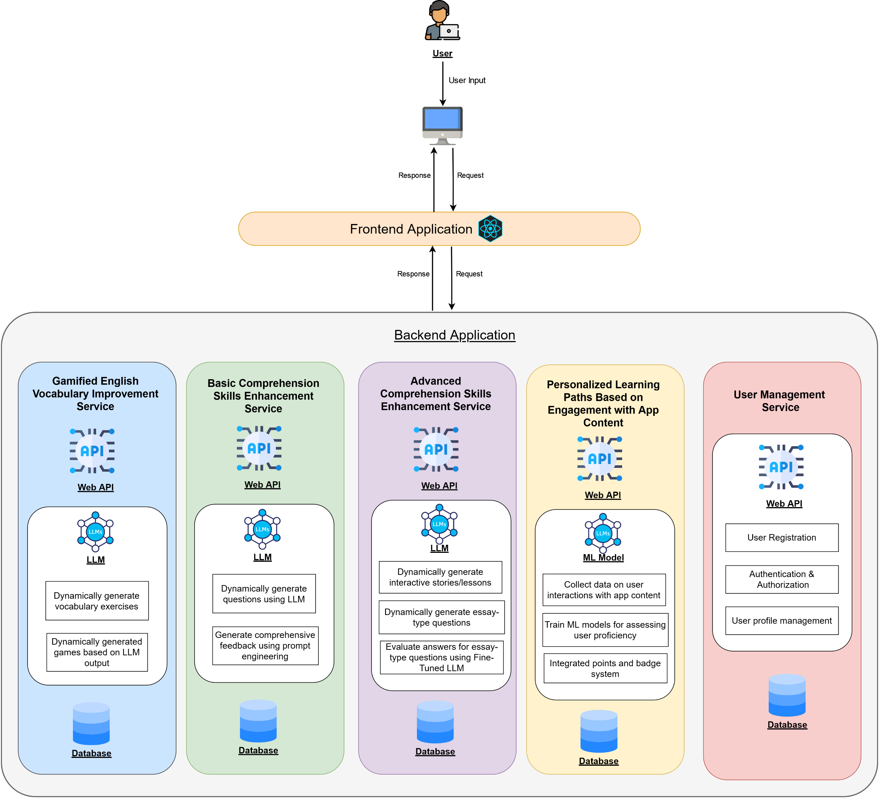
Overall System Diagram
8/23/2024
6
Notes:
This is a high level diagram of our proposed system. We intend use microservice architecture to implement our web application. In next sections you will hear more about these individual services.

Slide 7
AI-Powered Gamified English Vocabulary Improvement Module
IT21173790 – Sooriyaarachchi M.D.A
IT21173790 | Sooriyaarachchi M.D.A | 24-25J-027
8/23/2024
7

Slide 8




Background
Vocabulary is essential for effective communication and comprehension, especially in learning a second language like English.
Many educational tools rely on static vocabulary lists and traditional methods,
such as memorization and repetitive
exercises, which may not engage students effectively.
The module uses AI to create personalized exercises as a games based on students' vocabulary lists, catering to their specific learning levels and interests.
By providing dynamic and interactive content, the system offers a tailored and engaging learning experience, making vocabulary learning more enjoyable and effective.
IT21173790 | Sooriyaarachchi M.D.A | 24-25J-027
8/23/2024
8

Slide 9

Research Problem?
The challenge is to create a system that dynamically generates educational exercises as games and based on a student’s inputted vocabulary list, enhancing the learning experience.
Solving this issue will lead to a more engaging and personalized learning experience, ultimately improving vocabulary acquisition in language learning.
IT21173790 | Sooriyaarachchi M.D.A | 24-25J-027
8/23/2024
9

Slide 10
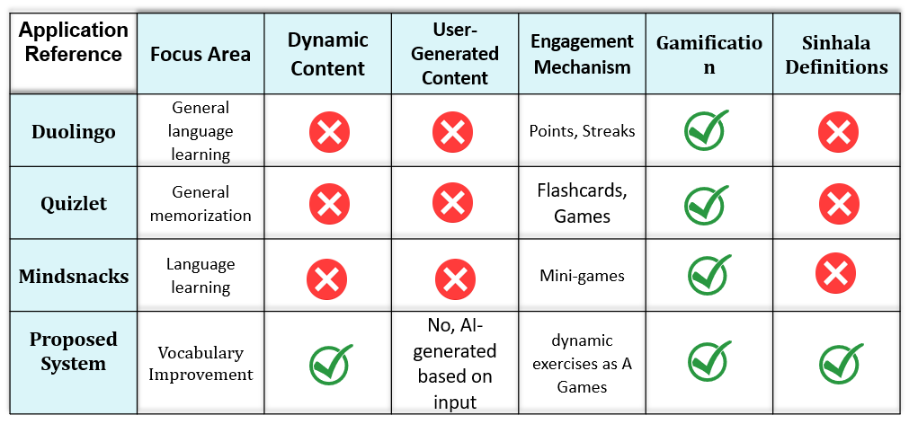
Research Gap
IT21173790 | Sooriyaarachchi M.D.A | 24-25J-027
8/23/2024
10

Slide 11



Specific and Sub Objectives
Fine-Tune a Large Language Model (LLM) to generate contextually relevant vocabulary exercises.
Develop a dynamically generated glossary that provides definitions, example sentences, and pronunciation guides for user-inputted vocabulary words.
Develop dynamically generated games based on LLM output
Specific Objective
To help high school students improve their English vocabulary and comprehension, we will create a module that generates interactive games and exercises based on the vocabulary words they provide
IT21173790 | Sooriyaarachchi M.D.A | 24-25J-027
8/23/2024
11

Slide 12
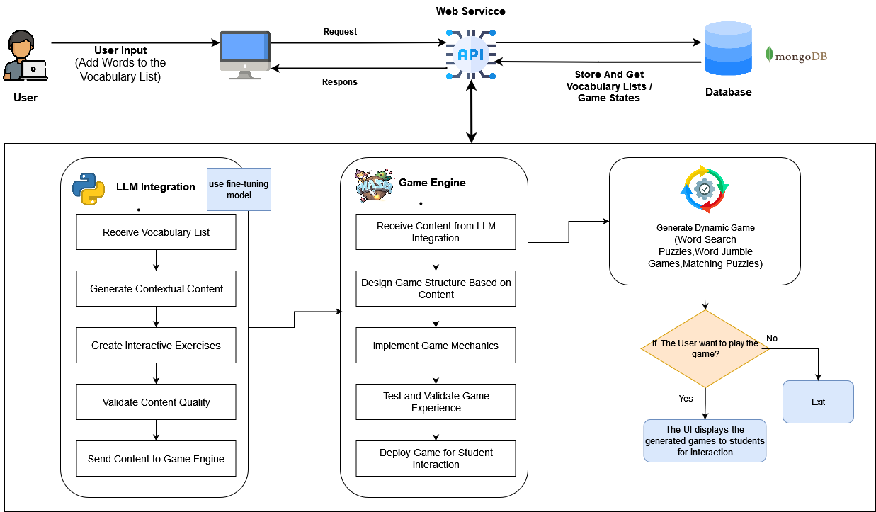
System Diagram
IT21173790 | Sooriyaarachchi M.D.A | 24-25J-027
8/23/2024
12

Slide 13










Technologies, Techniques, Algorithms
Technologies
React Js
Node JS and Express JS
Python and Django
Phaser.js/HTML5 game framework
MongoDB
Docker
Kubernetes
Techniques
Large Language Models (LLMs)
Machine Learning
Algorithms
Game Mechanics
IT21173790 | Sooriyaarachchi M.D.A | 24-25J-027
8/23/2024
13

Slide 14
System, Personnel, and Software Specification Requirements
Software Requirements
React Js
Node JS and Express JS
Python and Django
Unity and JS
MongoDB
Docker
Kubernetes
Functional Requirements
The system should allow students to input and manage their vocabulary lists effortlessly
Students should be able to add, edit, and remove words from their vocabulary lists.
The system should create gamified learning activities
The system should provide a user-friendly interface that allows easy navigation and access to features.
Non-Functional Requirements
The user interfaces should be user friendly to the user.
Users can trust the application's reliability and consistent performance.
The application is expected to produce highly accurate results.
The generated results should be more efficient and effective.
Personnel Requirements
Help Of English Teachers
IT21173790 | Sooriyaarachchi M.D.A | 24-25J-027
8/23/2024
14

Slide 15
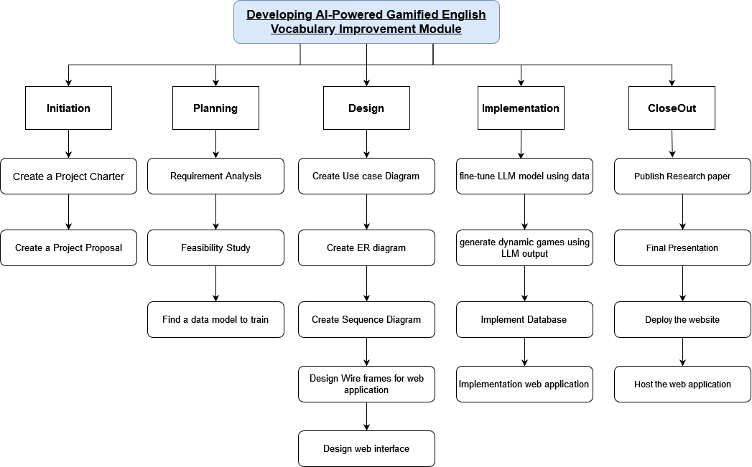
Work Breakdown Structure
IT21173790 | Sooriyaarachchi M.D.A | 24-25J-027
8/23/2024
15

Slide 16
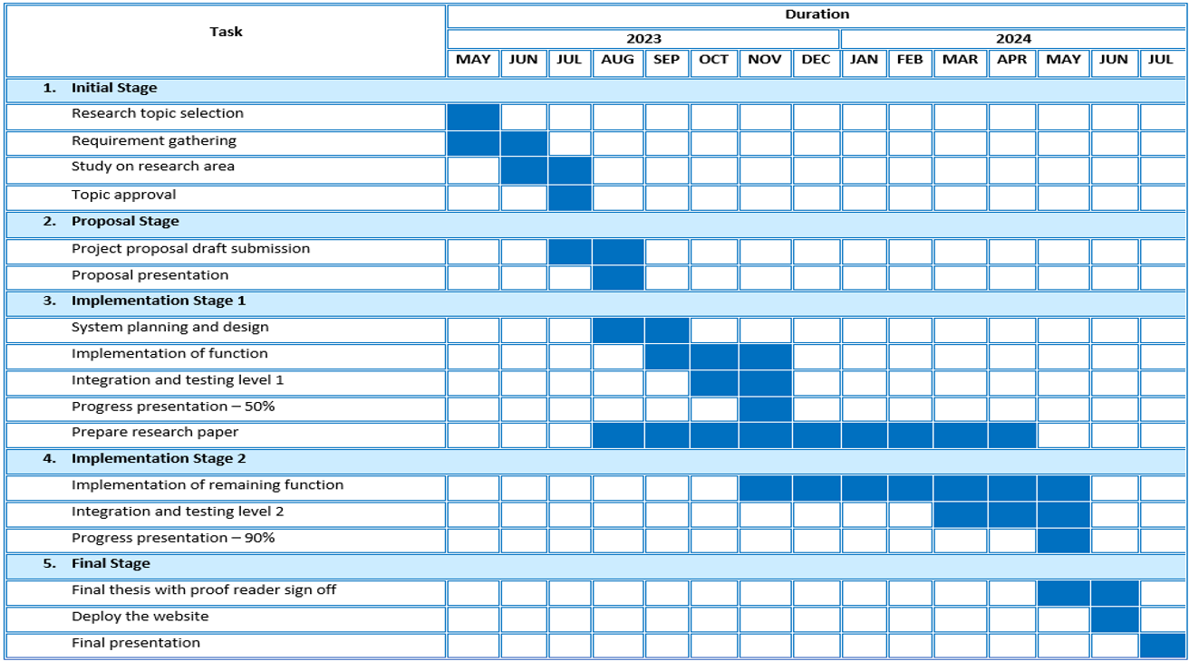
Gnatt Chart
IT21173790 | Sooriyaarachchi M.D.A | 24-25J-027
8/23/2024
16

Slide 17
References
[1] P. Dillenbourg, M. Jermann, and S. Gurtner, "Introduction to dual and interactive learning," New Learning Models, vol. 5, no. 3, pp. 45-55, 2006.
[2] T. B. Brown et al., "Language Models are Few-Shot Learners," arXiv preprint arXiv:2005.14165, 2020.
[3] A. K. Dey and G. D. Abowd, "Towards a Better Understanding of Context and Context-Awareness," Proc. HUC '99, 1999, pp. 304-307.
[4] N. G. Nagy, P. W. Herman, and R. C. Anderson, "Learning Words From Context," Reading Research Quarterly, vol. 20, no. 2, pp. 233-253, 1985.
17
8/23/2024
IT21173790 | Sooriyaarachchi M.D.A | 24-25J-027
8/23/2024
17

Slide 18
Basic Comprehension Skills Enhancement Module
IT21158322 – W. G. B. Senanayake
IT21158322 | W. G. B. Senanayake | 24-25J-027
8/23/2024
18

Slide 19
Background
Traditional educational tools for reading comprehension often lack the capability to dynamically generate quizzes and reading materials tailored to individual student needs.
Existing systems provide generic feedback, which may not address specific areas where a student needs improvement.
Leveraging AI technologies, particularly Large Language Models (LLMs) and prompt engineering, offers the potential to create personalized and dynamic educational experiences
IT21158322 | W. G. B. Senanayake | 24-25J-027
8/23/2024
19

Slide 20
Research Problem?
How can we leverage AI technologies, Large Language Models (LLMs) to dynamically generate quizzes and reading paragraphs
How can we use prompt engineering to provide effective, personalized feedback to improve students reading comprehension skills?
IT21158322 | W. G. B. Senanayake | 24-25J-027
8/23/2024
20

Slide 21
Research Gap
Feature/Tool | Khan Academy | Quizlet | Duolingo | AceReader Pro | Proposed System (Basic Comprehension Enhancement Module)
Dynamic Quiz Generation | No | No | Yes | No | Yes
Personalized Feedback | Yes | No | Limited | No | Yes
Dynamic Paragraph Generation | No | No | No | No | Yes
Prompt Engineering for Feedback | No | No | No | No | Yes
Comprehensive Feedback for Each Answer | Limited | No | Limited | No | Yes
IT21158322 | W. G. B. Senanayake | 24-25J-027
8/23/2024
21

Slide 22
Research Objectives
Main Objective:
Integrate AI-based technologies to generate dynamic quizzes
Integrate Prompt Engineering to provide comprehensive feedback for students’ answers.
Sub Objectives:
Develop a system that generates basic level quizzes (MCQ, Drag & Drop, Fill in the blanks, True/False).
Use prompt engineering to create comprehensive feedback for each student answer.
Dynamically generate reading paragraphs tailored to different comprehension levels.
IT21158322 | W. G. B. Senanayake | 24-25J-027
8/23/2024
22

Slide 23
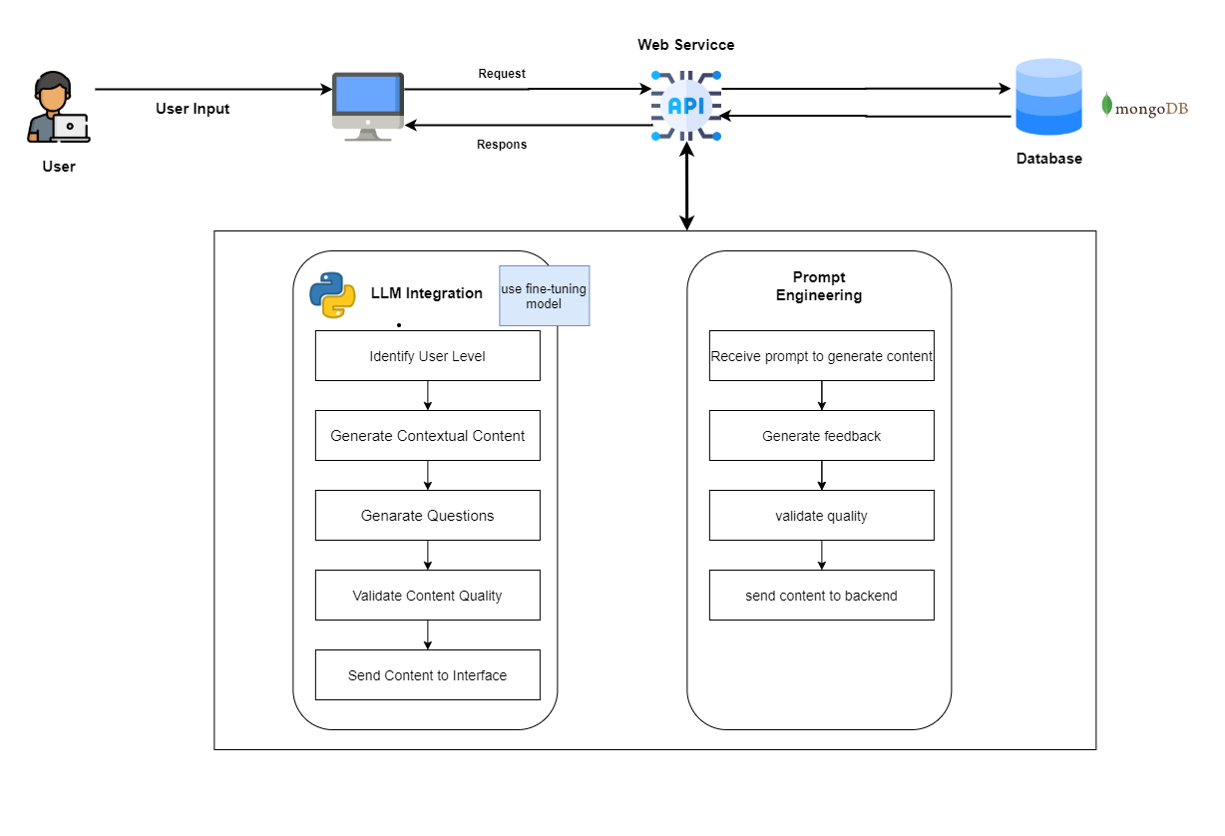
System Design
IT21158322 | W. G. B. Senanayake | 24-25J-027
8/23/2024
23

Slide 24
Tools & Technologies
Frontend - JavaScript & React
Backend - Python & Django
Database - PostgresSQL
Hosting – Azure
CI/CD – GitHub, Docker, Kubernetes content.
Large Language Models (LLMs) for generating quizzes and generating paragraphs
Prompt Engineering for refining AI-generated content.
IT21158322 | W. G. B. Senanayake | 24-25J-027
8/23/2024
24

Slide 25
Software Specification Requirements
Functional:
The system should be able to generate multiple types of quizzes (MCQ, Drag & Drop, Fill in the blanks, True/False) based on student proficiency levels.
The system should generate reading paragraphs tailored to different comprehension levels of students.
The system should provide detailed, personalized feedback for each student answer using prompt engineering techniques.
Feedback should highlight correct answers, explain mistakes, and offer suggestions for improvement.
Non Functional: Scalability , Performance, Security, Usability
IT21158322 | W. G. B. Senanayake | 24-25J-027
8/23/2024
25

Slide 26
Other Requirements
System:
High-performance servers to handle AI computations.
Secure databases for storing user data and quizzes.
Personal:
Expertise in AI/ML, backend development, and data security
Help Of English Teachers
IT21158322 | W. G. B. Senanayake | 24-25J-027
8/23/2024
26

Slide 27
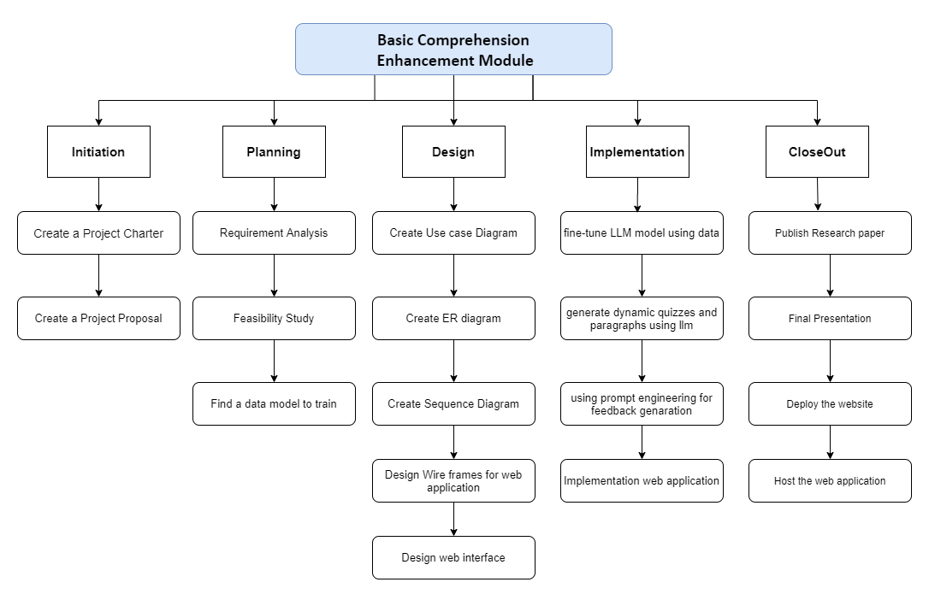
Work Breakdown Structure
IT21158322 | W. G. B. Senanayake | 24-25J-027
8/23/2024
27

Slide 28
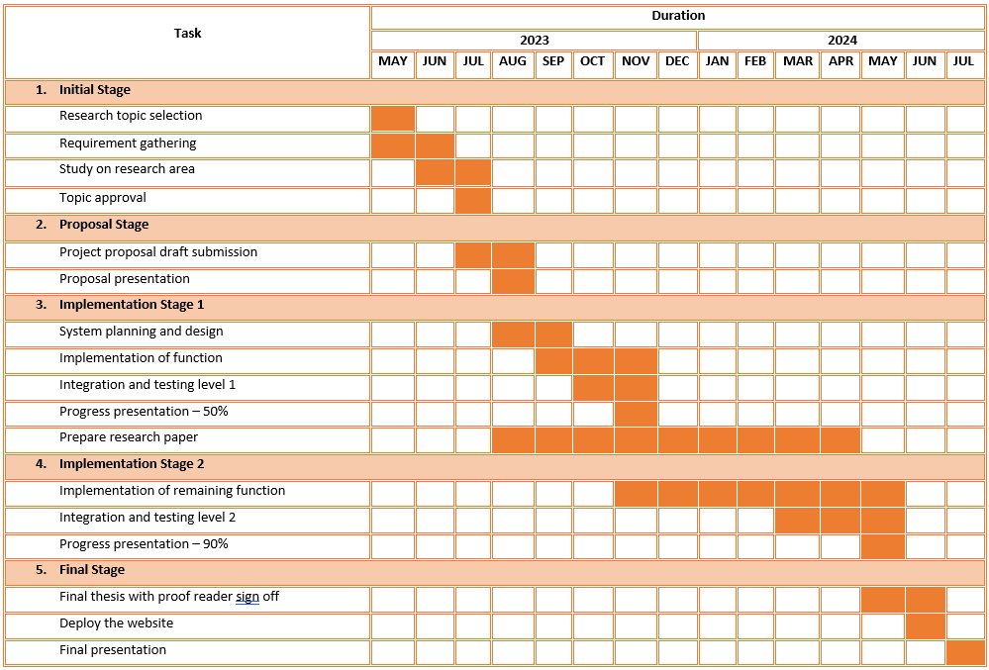
Gnatt Chart
IT21158322 | W. G. B. Senanayake | 24-25J-027
8/23/2024
28

Slide 29
References
[1] AI-Driven Feedback Mechanisms in E-Learning
Yang, S. J., Chen, I. Y., Kinshuk, & Chen, N. S. (2007). Enhancing learning performance with personalized feedback in web-based learning environments. Interactive Learning Environments, 15(3), 327-341.
[2] Prompt Engineering for Effective AI Communication
Brown, T. B., Mann, B., Ryder, N., Subbiah, M., Kaplan, J., Dhariwal, P., ... & Amodei, D. (2020). Language models are few-shot learners. arXiv preprint arXiv:2005.14165.
[3] Large Language Models: Radford, A., Wu, J., Child, R., Luan, D., Amodei, D., & Sutskever, I. (2019). Language models are unsupervised multitask learners. OpenAI Blog, 1(8), 9.
[4] Quizlet: Quizlet. (n.d.). Retrieved from https://quizlet.com/
29
8/23/2024
IT21158322 | W. G. B. Senanayake | 24-25J-027
8/23/2024
29

Slide 30
Advanced Comprehension Skills Enhancement Module
IT21118340 – S. A. D. S. Kumarathunga
IT21118340 | S. A. D. S. Kumarathunga | 24-25J-027
8/23/2024
30
Notes:
Hi everyone, My name is S. A. D. S. Kumarathunga. I’m responsible for ..

Slide 31


Background
What are Advanced Comprehension Skills?
Understanding the implied meaning of the text.
Ability to evaluate and analyze given text.
Skills:
Making inferences and deductions,
Connecting different parts of the text
Applying background knowledge
Finding the main idea, important facts, and supporting details
Summarizing
Generating and Asking Questions
IT21118340 | S. A. D. S. Kumarathunga | 24-25J-027
8/23/2024
31
Notes:
What exactly are advanced comprehension skills?
They go beyond simply understanding the words on a page.
Advanced comprehension involves grasping the implied meaning of a text, evaluating and analyzing the content, and applying critical thinking.
These skills include making inferences and deductions, connecting different parts of the text, applying background knowledge, identifying the main idea, important facts, and supporting details, summarizing, and generating as well as asking insightful questions.
Developing these skills is essential for deep, meaningful engagement with any text.

Slide 32

Research Problem?
Lack of dynamically adaptable content.
Lack tools to provide assessments for essay-type questions that typically require human evaluation.
IT21118340 | S. A. D. S. Kumarathunga | 24-25J-027
8/23/2024
32
Notes:
One challenge in English education today is the lack of dynamically adaptable content that can adjust to the varying needs of learners.
Also, another significant challenge is that, there are no tools capable of evaluating answers for essay-type questions.
Which means students have to wait for their English teacher to evaluate their work and provide feedback, which is time consuming process
Our proposed system intend to address these gaps and create more time-effective and personalized learning experiences.

Slide 33

Research Gap
Apps | Dynamic Content | Evaluate answers without human involvement | Provide feedback without human involvement
Generic Reading Apps
Duolingo |  | Only offer MCQ based questions | Limited feedback
AceReader Pro
ReadyRead
Smart AI Reading Assistant for Reading Comprehension
Proposed System
IT21118340 | S. A. D. S. Kumarathunga | 24-25J-027
8/23/2024
33
Notes:
This is a table of exiting tools.
As u can see most of them do not offer personalized content,
Answer evaluation nor comprehensive feedback.

Slide 34
Research Gap
Apps | Dynamic Content | Evaluate answers without human involvement | Provide feedback without human involvement
Generic Reading Apps
Duolingo |  | Only offer MCQ based questions | Limited feedback
AceReader Pro
ReadyRead
Smart AI Reading Assistant for Reading Comprehension
Proposed System
IT21118340 | S. A. D. S. Kumarathunga | 24-25J-027
8/23/2024
34
Notes:
This is a table of exiting tools.
As u can see most of them do not offer personalized content,
Answer evaluation nor comprehensive feedback.

Slide 35
Research Objectives
Main Objective: Provide a platform to improve advanced comprehension skills such as Sequencing, Summarizing, Self-questioning
Sub Objectives:
Fine-Tune LLM model to generate dynamic content
Fine-Tune LLM model to accurately evaluate answers without human involvement
Develop the most suitable prompts to generate dynamic content and evaluate answers
IT21118340 | S. A. D. S. Kumarathunga | 24-25J-027
8/23/2024
35
Notes:
The main objective of my research is to provide a platform that enhances advanced comprehension skills, such as sequencing, summarizing, and self-questioning.
To achieve this, I have set several key sub-objectives:
fine-tuning a large language model to generate dynamic content,
refining the model to accurately evaluate answers without human involvement,
and developing the most effective prompts to ensure both content generation and answer evaluation

Slide 36
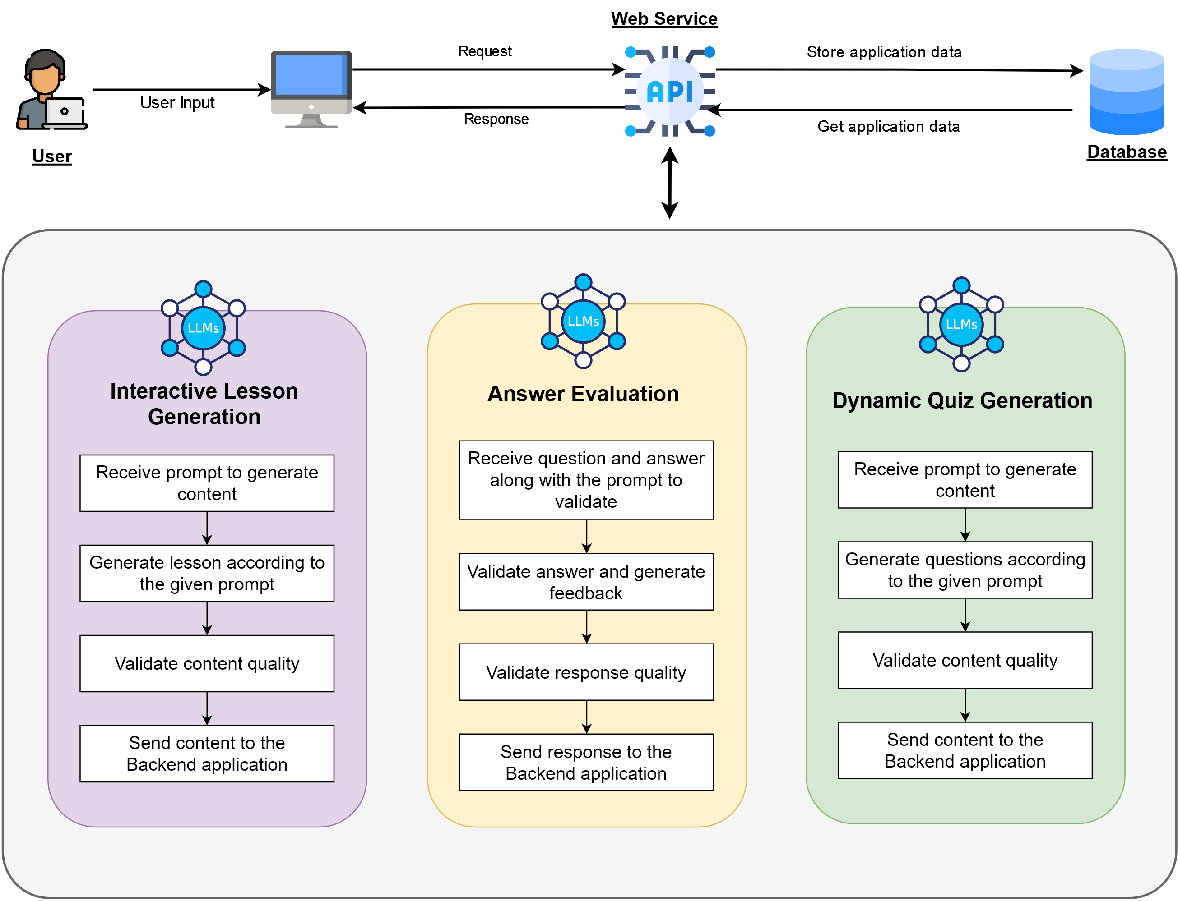
System Diagram
IT21118340 | S. A. D. S. Kumarathunga | 24-25J-027
8/23/2024
36
Notes:
The proposed service consist of three modules.
Interactive lesson generation
Dynamic quiz generation
Answer evaluation

Slide 37




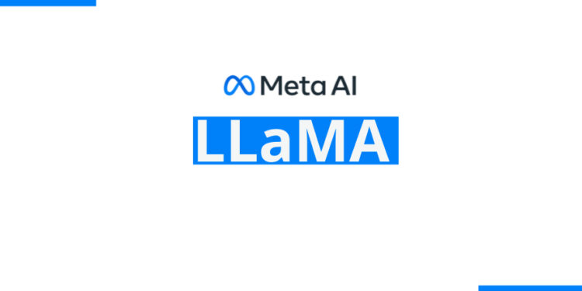


Tools & Technologies
Frontend - JavaScript & React
Backend - Python & Django
Database – Postgres SQL
LLM Model – Llama
Fine-Tuning – Vertex AI
Prompt Engineering Techniques
Zero-Shot Prompting, Few-Shot Prompting
Hosting – Azure, Hugging Face
CI/CD – GitHub, Docker, Kubernetes
IT21118340 | S. A. D. S. Kumarathunga | 24-25J-027
8/23/2024
37
Notes:
This is a list of tools and technologies I intent use.
For the frontend, I employ JavaScript and React, while the backend is powered by Python and Django.
Data is managed using Postgres SQL,
Fine-tuned Llama LLM model combined with prompt engineering is used for advanced language processing.
Fine-tuning process is conducted using Vertex AI
Web Hosting is managed on Azure, while models are hosted in Hugging Face

Slide 38
Software Specification Requirements
Functional:
The system should be able to dynamically generate content given on user's interest and skill level
The system should be able to accurately evaluate user answer without human intervention
The system should be able to give extensive feedback about user's answer
Non Functional: Accuracy, Performance, Availability, Usability
IT21118340 | S. A. D. S. Kumarathunga | 24-25J-027
8/23/2024
38
Notes:
Proposed system is designed with key functional goals in mind.
It will dynamically generate content tailored to the user's interests and skill level,
Accurately evaluate user responses without human intervention,
Provide extensive feedback on their answers.
On the non-functional side, focus is on ensuring accuracy, high performance, availability, and user-friendliness

Slide 39
Other Requirements
Software:
Languages: JavaScript & Python
Web Frameworks: React & Django
Database: PostgresSQL
AI/ML: Llama, Vertex AI, LangChain
CI/CD – GitHub, Docker, Kubernetes
Personal:
Expertise in
Web frameworks
LLM related tools
Database Design
System Design & Deployment
IT21118340 | S. A. D. S. Kumarathunga | 24-25J-027
8/23/2024
39
Notes:
This is a list software I intend use to develop our system.
On the personal requirements, Expertise in web frameworks, LLM-related tools, database design, and system design and deployment are required.

Slide 40
Work Breakdown Structure
Initiation
Project Charter
Project Proposal
Planning
Requirement Analysis
Collect data
Design
Publish research paper
Implement
Close Out
Feasibility Study
Create Use Case Diagram
Create ER Diagram
Design Wire Frames for UI
Design User Interface
Research with LLM model
Develop prompt for generating content, assessment and feedback
Implement Backend application
Implement Frontend application
Final presentation
Deploy web application
Topic Assesment
IT21118340 | S. A. D. S. Kumarathunga | 24-25J-027
8/23/2024
40
Notes:
This diagram workload distribution for the research project.
There are five phases with multiple key tasks
We are currently in the initiation phase

Slide 41
Gnatt Chart
IT21118340 | S. A. D. S. Kumarathunga | 24-25J-027
8/23/2024
41
Notes:
This Gnatt chart represent the time estimates for the workload in research project

Slide 42
References
[1] K. Moholkar, M. Chaturvedi, A. Jain, A. Parkhe and K. Singh, "Machine Learning Techniques for Descriptive Answer Evaluation: A Comprehensive Survey," 2024 International Conference on Inventive Computation Technologies (ICICT), Lalitpur, Nepal, 2024, pp. 1412-1419, doi: 10.1109/ICICT60155.2024.10544714.
[2] P. Mirabal, M. Castillo-Sanhueza, R. Curín-Zarate and O. O. Calzadilla-Pérez, "Use of Language Models based on Deep Learning to improve reading comprehension," 2023 42nd IEEE International Conference of the Chilean Computer Science Society (SCCC), Concepcion, Chile, 2023, pp. 1-6, doi: 10.1109/SCCC59417.2023.10315757.
[3] Laban, P., Wu, C., Murakhovs'ka, L., Liu, W., & Xiong, C. (2022). Quiz Design Task: Helping Teachers Create Quizzes with Automated Question Generation. NAACL-HLT.
[4] Xia, W., Mao, S., & Zheng, C. (2024). Empirical Study of Large Language Models as Automated Essay Scoring Tools in English Composition Taking TOEFL Independent Writing Task for Example. ArXiv, abs/2401.03401.
[5] Hussein, M.A., Hassan, H.A., & Nassef, M. (2019). Automated language essay scoring systems: a literature review. PeerJ Computer Science, 5.
42
8/23/2024
IT21118340 | S. A. D. S. Kumarathunga | 24-25J-027
8/23/2024
42
Notes:
I would like invite Asanka to present his section.

Slide 43
Personalized Learning Paths Based on Engagement with App Content
IT21182396 – A. P. Ranaweera
IT21182396 | A. P. Ranaweera | 24-25J-027
8/23/2024
43

Slide 44
Background
The personalized learning platform aims to enhance English reading and comprehension using adaptive learning methods.
It measures student performance through metrics such as response times and error patterns etc.
Machine learning algorithms analyze these metrics to accurately assess each user's proficiency and determine the appropriate level of content to present next.
IT21182396 | A. P. Ranaweera | 24-25J-027
8/23/2024
44
Notes:
Identify student current performance level and develop a personalized learing path base on it . So that after identify current level… system predict which level is the appropriate quiz for next
Based on what the user entered in the quiz ,,,, at that time ML algorithm analyze the data accurately… assess each user s proficiency…. And determine the appropriate level of quiz to present to next.

Slide 45
Research Problem?
How can machine learning algorithms effectively measure a learner's current proficiency level in reading comprehension and accurately determine the appropriate next level of difficulty for personalized learning paths?
IT21182396 | A. P. Ranaweera | 24-25J-027
8/23/2024
45
Notes:
That kind of english reading and comprehension improving platfor............
We have compared the existing platgorm and.... ifentifyy what feature should be included to our ptoposed one.... included the additional things of our proposed applicationWe have included personalized learning path feature in our proposed systemPlan to measure student performance in several ways

Slide 46


Research Gap
Feature / System | Proposed System | Duolingo | AceReader Pro | Quizlet | ReadyRead
Personalized Learning Path |  | Limited
Dynamic Difficulty Adjustment |  | Limited
Real-Time Performance Tracking |  |  | Limited |  | Limited
Pre-trained Model for Difficulty
Behavioral Analytics
IT21182396 | A. P. Ranaweera | 24-25J-027
8/23/2024
46
Notes:
That kind of english reading and comprehension improving platfor............We have compared the existing platgorm and.... ifentifyy what feature should be included to our ptoposed one.... included the additional things of our proposed application
We have included personalized learning path feature in our proposed system Plan to measure student performance in several ways
There are anlyze the time pet for session and analyzing the time spent on one question … according to that odentifying student level
For that compare with the time spent by him…time it usually takes to complete a question of that level
Comparison of the number of qus student get wrong in that level session
Compare his mistakes wrong patterns
The difficulty level of the question can be enterd acodrindgto how the student felt at the end of the question
anlyze the behavior in this earkier kevel
Use this kind of parameters buy analize accordingly he ca gather numb er of point acrding to it determine what kind of level would be the

Slide 47
Research Objectives
Main Objective:
Identify and analyze learner personalized learning paths based on engagement with app content and identify student interests.
Sub Objectives:
Collect data on user interactions with app content, including time spent, frequency of access, and types of content engaged with.
Use machine learning techniques to train models for assessing user proficiency and identifying interests.
Integrate a points and badge system to enhance user engagement and motivation. Track and analyze the impact of these elements on user performance and satisfaction.
IT21182396 | A. P. Ranaweera | 24-25J-027
8/23/2024
47
Notes:
There are anlyze the time pet for session and analyzing the time spent on one question … according to that odentifying student level
For that compare with the time spent by him…time it usually takes to complete a question of that level
Comparison of the number of qus student get wrong in that level session
Compare his mistakes wrong patterns
The difficulty level of the question can be enterd acodrindgto how the student felt at the end of the question
anlyze the behavior in this earkier kevel
Use this kind of parameters buy analize accordingly he ca gather numb er of point acrding to it determine what kind of level would be the

Slide 48
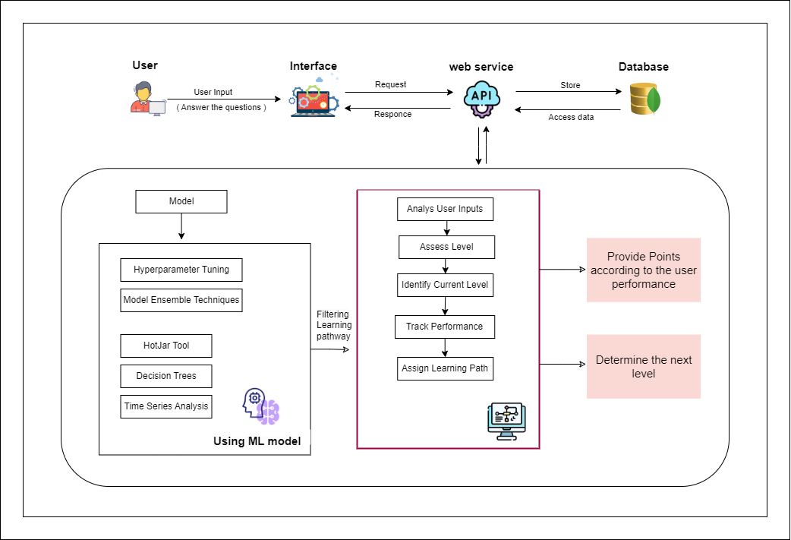
System Design
IT21182396 | A. P. Ranaweera | 24-25J-027
8/23/2024
48
Notes:
There are anlyze the time pet for session and analyzing the time spent on one question … according to that odentifying student level
For that compare with the time spent by him…time it usually takes to complete a question of that level
Comparison of the number of qus student get wrong in that level session
Compare his mistakes wrong patterns
The difficulty level of the question can be enterd acodrindgto how the student felt at the end of the question
anlyze the behavior in this earkier kevel
We are plane to train data set that include average time taken for each level of questions
After we gather user inputs analize varies type of models .. So that how many presentage effect to the output … from this type of parameter .. According to that finally cal how many point gather from current level.
Use this kind of parameters buy analize accordingly he ca gather numb er of point acrding to it determine what kind of level would be the next

Slide 49
Tools & Technologies
Frontend - JavaScript & React
Backend - Python & Django
Database - PostgresSQL
Hosting – Azure
CI/CD – GitHub, Docker, Kubernetes content.
Machine learning - Hyperparameter Tuning / Model Ensemble Techniques
Scikit-learn
MLflow
IT21182396 | A. P. Ranaweera | 24-25J-027
8/23/2024
49

Slide 50
Software Specification Requirements
Functional:
The system should Identify Student Current Performance Level and Interest Fields
The system should recommend learning paths based on user interests, performance, and engagement.
The system must adapt learning paths based on user progress
The system should award points and badges to users based on their engagement and achievements.
Non Functional: Accuracy , Performance, Availability, Usability
IT21182396 | A. P. Ranaweera | 24-25J-027
8/23/2024
50

Slide 51
Other Requirements
Software:
Languages: JavaScript & Python
Web Frameworks: React & Django
Database: mongo DB
ML: Auto-sklearn , MLflow
CI/CD – GitHub, Docker, Kubernetes
Personal:
Expertise in Web frameworks
Expertise in ML related tools
Expertise in Database Design
Expertise in System Design & Deployment
IT21182396 | A. P. Ranaweera | 24-25J-027
8/23/2024
51

Slide 52
Work Breakdown Structure
Initiation
Project Charter
Project Proposal
Planning
Requirement Analysis
Collect data
Design
Publish research paper
Implement
Close Out
Feasibility Study
Create Use Case Diagram
Create ER Diagram
Design Wire Frames for UI
Design User Interface
Develop Algorithm
Develop Dataset
Implement Backend
Implement Frontend
Final presentation
Deploy web application
IT21182396 | A. P. Ranaweera | 24-25J-027
8/23/2024
52

Slide 53
Gnatt Chart
IT21182396 | A. P. Ranaweera | 24-25J-027
8/23/2024
53

Slide 54
References
[1] B. Bouihi and M. Bahaj, "Ontology and rule-based recommender system for e-learning applications", International Journal of Emerging Technologies in Learning (Online), vol. 14, no.
[2] D. Shi, T. Wang, H. Xing and H. X., "A learning path recommendation model based on a multidimensional knowledge graph framework for e-learning", Knowledge Based Systems, vol. 195, no. 105618, 2020.
[3] https://www.cachefly.com/news/harnessing-ai-and-machine-learning-for-personalized-learning-experiences/
[4] https://www.nudgenow.com/blogs/personalized-learning-paths-student-engagement
[5] https://www.analyticsvidhya.com/blog/2022/02/a-comprehensive-guide-on-hyperparameter-tuning-and-its-techniques/
54
8/23/2024
IT21182396 | A. P. Ranaweera | 24-25J-027
8/23/2024
54

Slide 55
Supportive Information Commercialization
Target Audience: High school students, English language learners, Educators
Business Model: Software as a Service
Free tier: Ad Supported ( Advertisements from education institutions)
Premium version: Subscription based
Marketing:
Establish partnerships with educational institutions to pilot and scale the product
Explore collaborations with government agencies and non-profit organizations focused on literacy and education
55
8/23/2024
8/23/2024
55

Slide 56
Supportive Information Budget
Resource​​ | Cost Per Month​ | Cost (LKR)​
Direct Costs​ | ​ | ​
Deployment cost​ | $28​ | LKR 15000.00
Domain​ | $15​ | LKR 5000.00
Indirect Costs​ | ​ | ​
Wi-Fi / mobile data​ | $​5 | LKR 3000.00​
56
8/23/2024
8/23/2024
56

Slide 57
Thank You
Any questions??
57
8/23/2024
8/23/2024
57

